Slide 1
Restricted Category & Type Certificate Holders Forum
March 7th, 2017

Slide 2
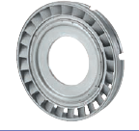
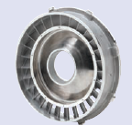
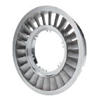
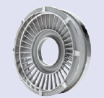
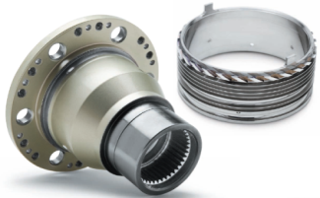
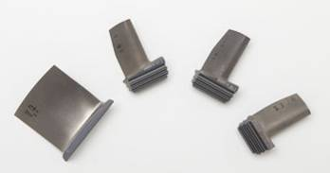
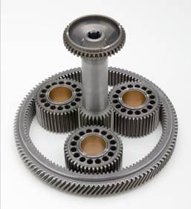
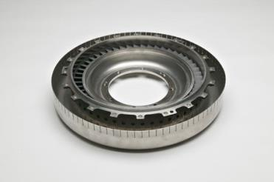
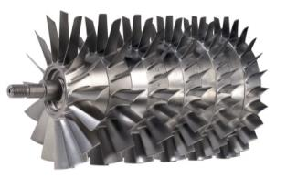
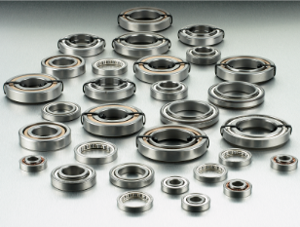
EXTEX Replacement Parts
PT Air Seal
Turbine Nozzles – 1st through 4th Stages
Compressor Stub Shaft
Blades
1,600+ approvals for RR250, PT6, T53, Bell Medium AC and APU’s
Done Primarily Through “Test & Computation”
Gear Set
Compressor Wheels
1st Stage Turbine Nozzle (T53)
Bearings

Slide 3
Technical Innovation – Nozzles
Improved material
Thicker trailing edges, outer band
Optimized flow area
Erosion/corrosion resistant coating
Rolls-Royce changed their nozzle material 2 years later!

Slide 4
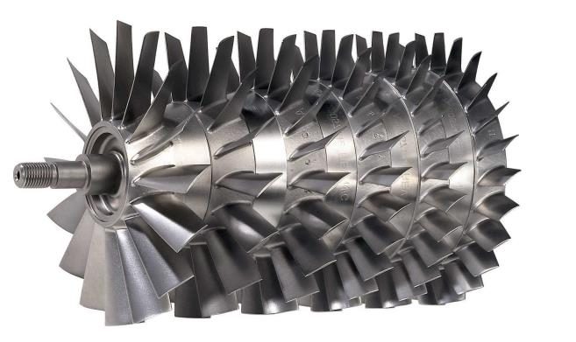
Technical Innovation – Compressor Wheels
Improved material
Forged, not cast
No coating required
4.2% power increase
1.5% Specific Fuel Consumption reduction
Rolls-Royce changed to Our Design 15 years later!

Slide 5
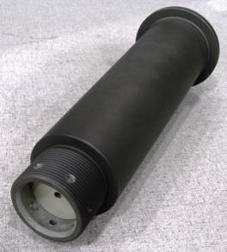
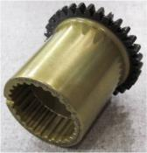
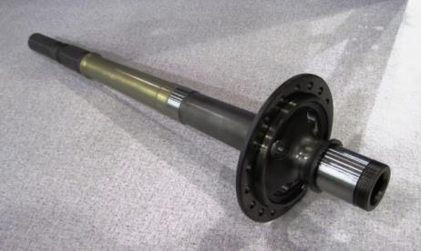
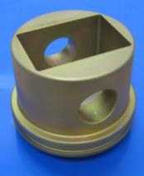
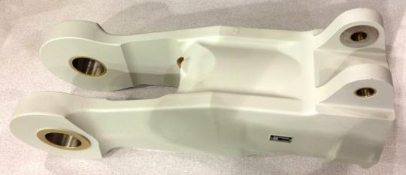
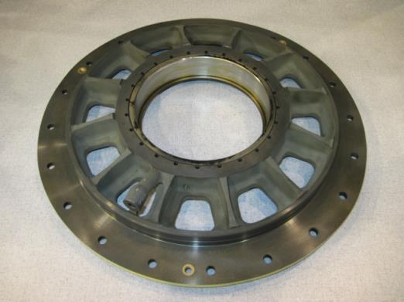
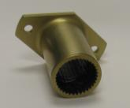
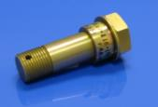
Bell Replacement Parts
Offering savings on cost-driving parts installed on dynamic components such as:
  Supports
  Fittings
  Grips
  Bearings
  Cases
  Barrels
  Shafts
  Bolts
  “Bell Approved” listing available.

Slide 6
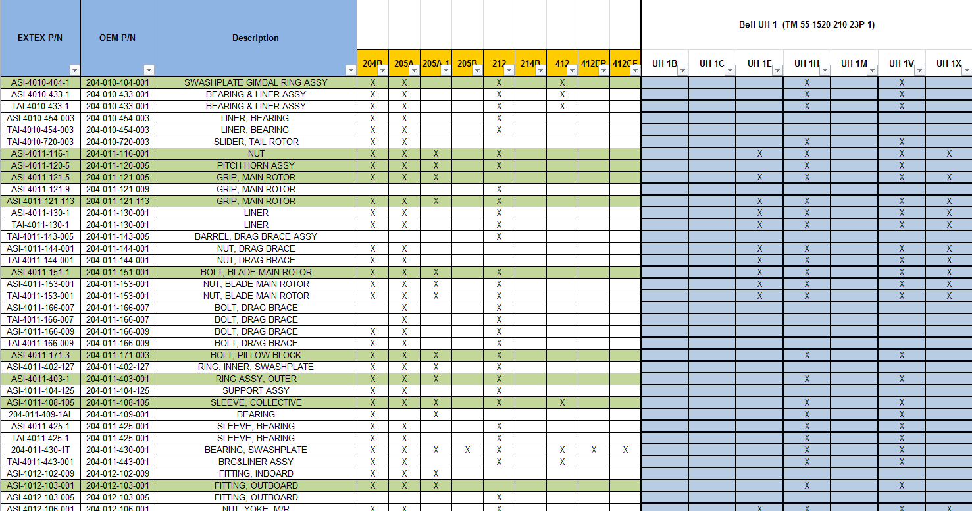
Bell Replacement Parts

Slide 7
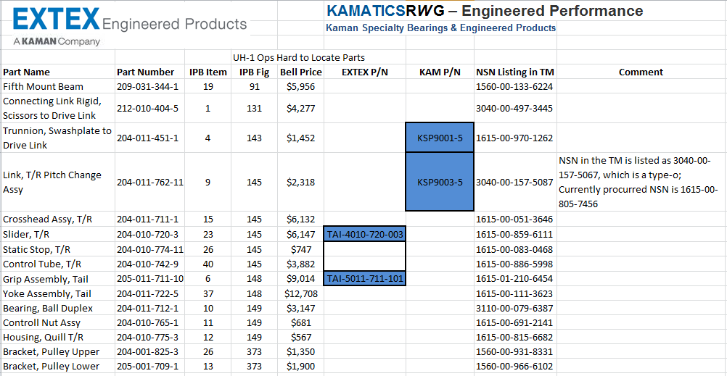
Hard to find Parts

Slide 8
Next Steps
How can you help us to help you?
Information Sharing
  Type Certificate AC data.
    We’ve been reaching out to all of the TC holders to collect the AC data. This will improve and increase our ability add aircraft to our part eligibility
    Collect and review historical utilization (2-3years).
    EXTEX will use this information to align our manufacturing schedule and project 24-36 month going forward with you.
  Connect the details on part lists and pricing to your DOM’s, buyers and mechanics.
    We’ll work directly with you / your teams to connect the dots and provide solutions.

Slide 9
Next Steps
Help us, help you continued…
  Look at What else is needed to be created?
    If we can forecast with your fleet and show us the line of sight to the current and future needs, we’ll pursue it.
  Open a PO
    With scheduled consumptions, over the next 24-36 months, realizes the deepest discounts up front.
  Other PMA Organizations.
    We are looking to connect with other PMA facilities that have similar products as to not recreate something that already exists. Instead we’ll be working to create a better resource network .

Slide 10
EXTEX summary
EXTEX has 1600+ FAA Approvals.
We are Producing a list of “Bell Approved Replacement Parts”
EXTEX Thumb drives, literature and Team members can provide additional information
Visit with EXTEX at booth # 7351.
We are Collecting TC holder data for faster FAA eligibility adds.

Slide 11

Meet us at our booth (7351) and let’s have a conversation!!
EXTEX Engineered Products, Inc.
A KAMAN Company
C: +1 480.225.8192
O: +1 480.606.3069
E: Reid.Selover@Kaman.com
W: http://www.extexengineered.com/
340 E Germann Rd, Suite 113 | Gilbert, Arizona 85297 | USA

